Slide 1









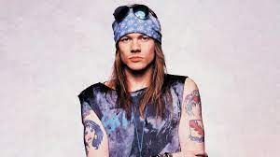


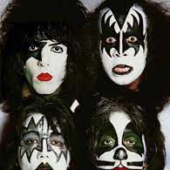


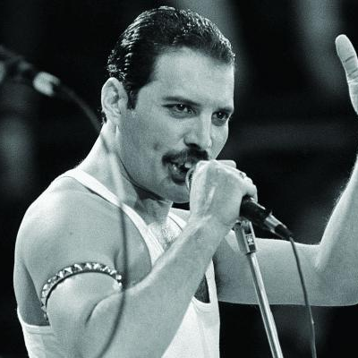

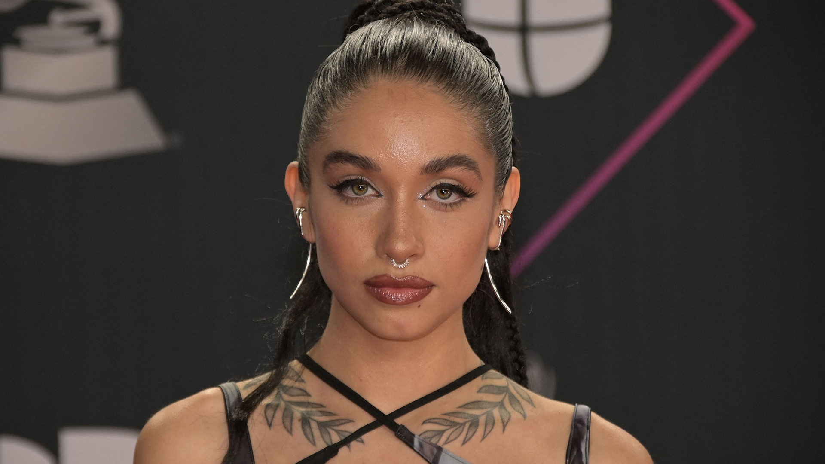
Group 2
Harmonic Insights: Uncovering Spotify's Pricing Dynamics
Start Presentation
MGMT 63800 Pricing Strategy

Slide 2





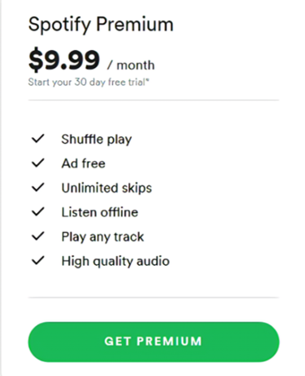
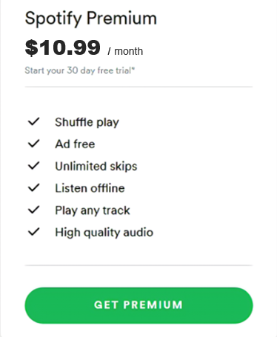


Group 2
Problem Statement
Maintaining Status
Problem Statement
Despite revolutionizing music consumption since its founding in 2006, Spotify faces the challenge of maintaining its dominant position in the fiercely competitive music streaming industry. With over 380 million monthly active users as of 2022, the company must address the need for ongoing innovation, and strategic pricing to sustain its market leadership amidst increasing competition.
Pricing Plans
Effect of 10%
Volume Up
Old and New
Features
Conjoint Analysis
Conclusions

Slide 3





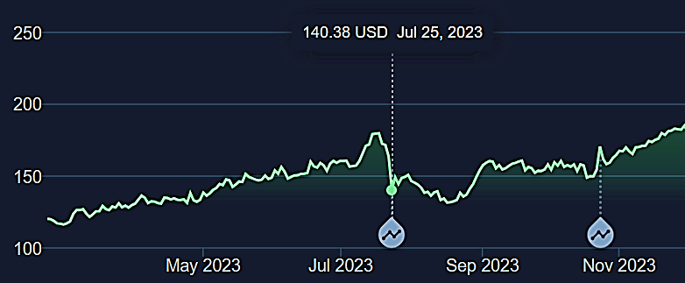
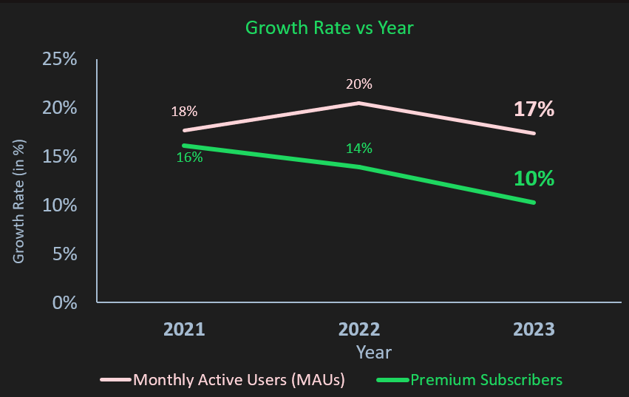

Group 2
Pricing Plans
Free | $0.00 | 1 month | No | with Youtube Premium
Individual | $10.99 | $10.99 | $9.99 | $10.99
Family | $16.99 | $16.99 | $15.99 | $14.99
Student | $5.99 | $5.99 | $0.99 | $5.49
US military discount | No | No | Yes | No
Problem Statement
Pricing Plans
Effect of 10%
Volume Up
Features
Conjoint Analysis
Conclusions

Slide 4

Group 2
Effect of 10% Price Increase
Problem Statement
In July 2023, Spotify raised prices across its four subscription plans in the United States. The changes resulted in an increase of $1 to $2 per month for U.S. subscribers
Pricing Plans
Effect of 10%
Volume Up
Features
The stock prices dropped the day Spotify announced 10% increase in their subscription prices
Conjoint Analysis
Conclusions

Slide 5




Group 2
Volume Up on Growth
Problem Statement
Pricing Plans
Refining Spotify’s Approach
Effect of 10%
Volume Up
Features
Why Conjoint Analysis ?
Conjoint Analysis
To see how consumers value the different features and attributes of streaming providers of different brands, we performed Conjoint Analysis
Conclusions

Slide 6

Group 2
Conjoint Analysis : Features
Problem Statement
Free trial period | 30 days | 30 days to 3 months | 90 days | 30 days
Music library size | Over 100 million | Over 100 million | 100 million | 100 million
Maximum bit rate | 320Kbps | 256Kbps, 1,152 Kbps (HD estimated) | 256Kbps, 3,730Kbps (HD) | 256Kbps
Offline listening | Mobile and desktop | Mobile and desktop | Mobile and desktop | Premium, mobile only
Radio stations | Yes | Yes | Yes | Yes
Podcasts | Yes | No | Yes | Yes
Music videos | Yes | Yes | No | Yes
Music locker functionality | No | Yes | No | Yes
Pricing Plans
Effect of 10%
Volume Up
Features
Conjoint Analysis
Conclusions

Slide 7

Group 2
Problem Statement
Pricing Plans
Effect of 10%
Volume Up
Features
Finding
Conjoint Analysis
It is visible that consumers really value the feature of music videos.
Conclusions

Slide 8
Group 2
Problem Statement
Pricing Plans
Effect of 10%
Volume Up
Features
Your Title Topic # 2
Finding
Conjoint Analysis
Brand and Music video are the two most important features in terms of relative importance
Conclusions
Expositor Name
Role can be here

Slide 9
Conjoint Analysis
Group 2
Brand | Music Video | Price | Podcast | Download | First Choice Rule | Share of Pref. Rule
Spotify | No | 10.99 | Yes | Yes | 27% | 27%
Spotify | Yes | 10.99 | Yes | Yes | 42% | 41%
Problem Statement
Pricing Plans
Effect of 10%
Volume Up
Observations
Features
Growth of a 14-15% increase in the user base was observed with a new addition of a Music Video Feature.
Users are willing to pay ~ $1.7 for this feature
Conjoint Analysis
Conclusions
Expositor Name
Role can be here

Slide 10

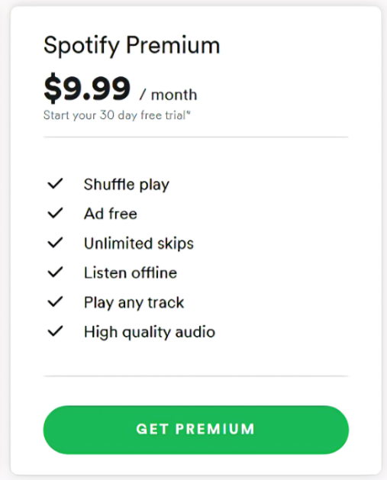

Group 2
Conclusion:
Proposal
Problem Statement
New Pricing Tier for Music Video Fans
Pricing Plans
Effect of 10%
Plus
$ 10.99
$ 11.99
Volume Up
Features
Conjoint Analysis
Music Video
Conclusions

Slide 11

Group 2
Conclusion:
Problem Statement
Recommendations
Pricing Plans
Effect of 10%
Volume Up
Add New Offerings: Spotify could introduce a music video streaming tier
Rewards Program: Premium subscribers now receive one free month of Premium Plus access
Improve brand awareness: Spotify could target niche markets to attract new customers.
Features
Conjoint Analysis
Conclusions

Slide 12
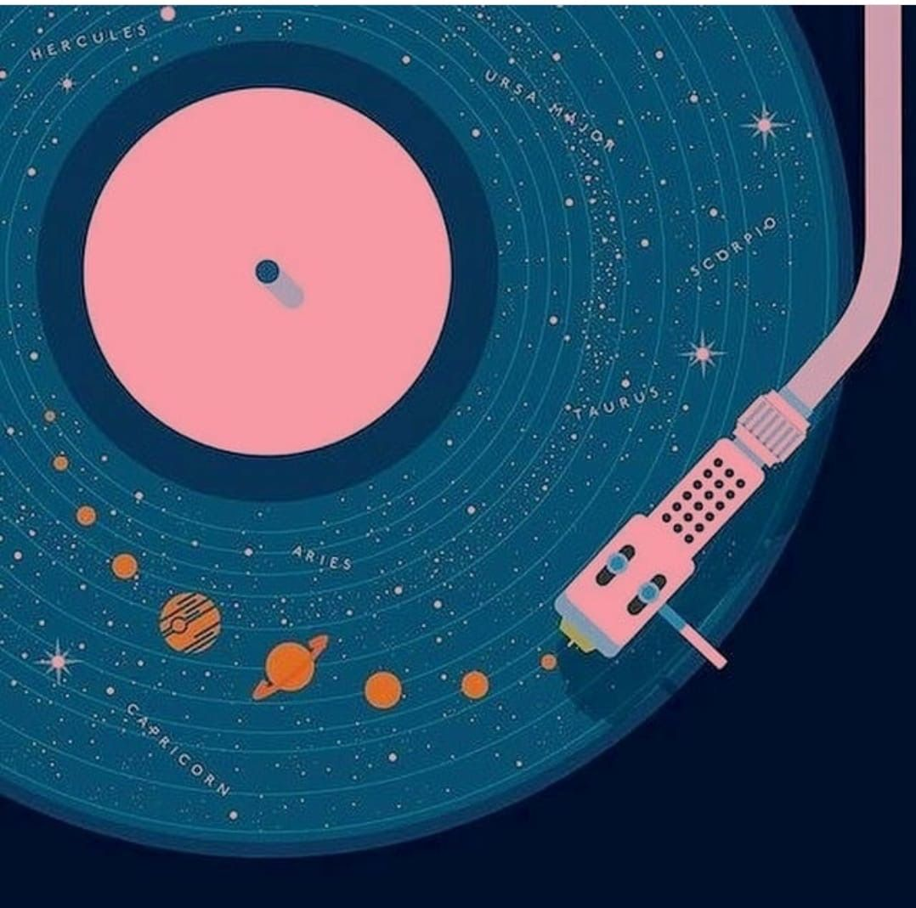
Group 2
Concluding:
Problem Statement
Future Scope & Biases
Pricing Plans
Effect of 10%
Volume Up
Survey a larger and more diverse sample size
Analyze more features
Feasibility analysis of the new music video feature
Target new markets
Features
Conjoint Analysis
Conclusions

Slide 13

Piyush Kakde, Archita Ray, Ashvin Raj, Sahana Reddy, Akshita Sharma

